Slide 1
Ear Matching Tool

Slide 2
Our Goal:
Using Matlab to create a useful tool that could identify different ears with multiple functions. As the result, this tool will be useful for student and scientist to study about ear structure and HRTF related with the ear, and easier for them to do research with the individuals’ differences and the effects on HRTF.
This project are meaning to be used for educational purpose, and scientific research in engineering and biology field.

Slide 3

Hu Moment Invariants
Ear Matching Algorithm
1
2
Eigenears
User prompted for ear image
Y
Best HRTF match from database
Input ear
Q-vector analysis
3
N
4
Measurement Match
Webcam takes picture
Algorithms chosen from list of ear recognition research papers

Slide 4
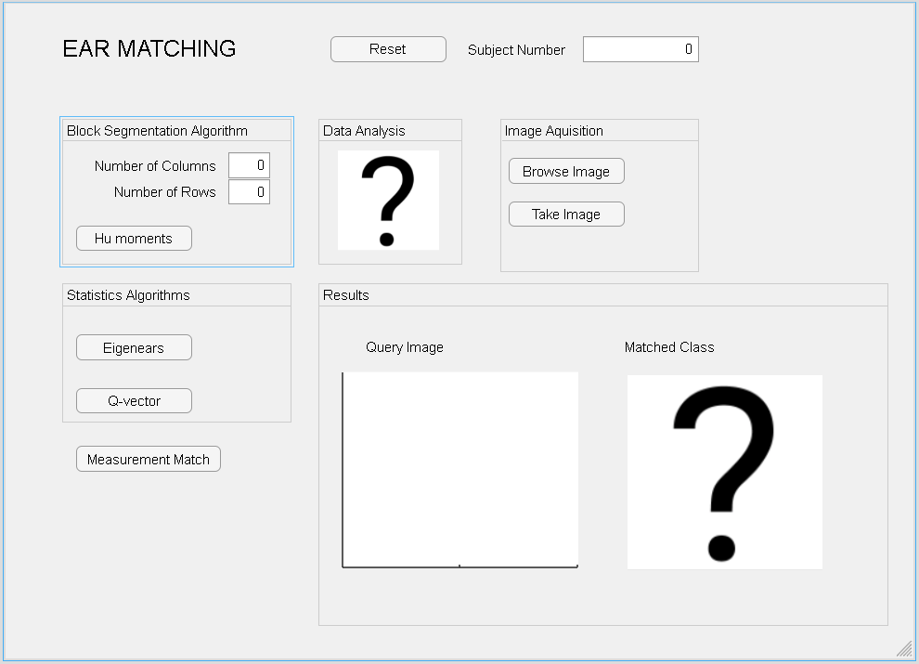
Reset Button
Final output number in the database
Hu Moment matching algorithm with input of columns and rows
Input the Ear Image into the app by browse or camera
EigenEars Matching Algorithm Button
Output (matched) Image Display
Q-Vector Matching Algorithm Button
Measurement Matching akgorithm Button
Input Image Display

Slide 5
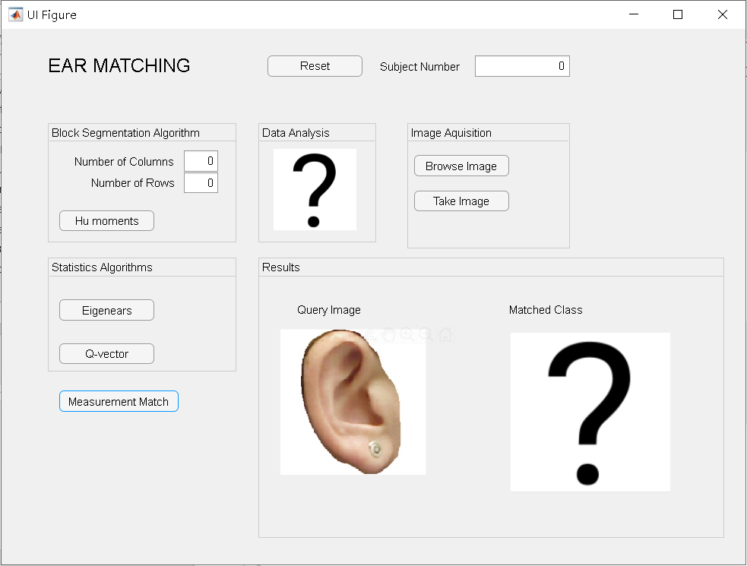
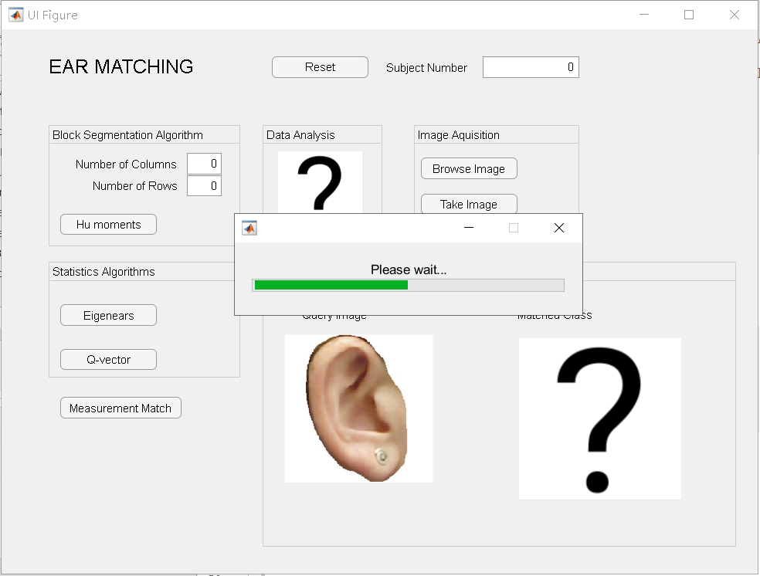
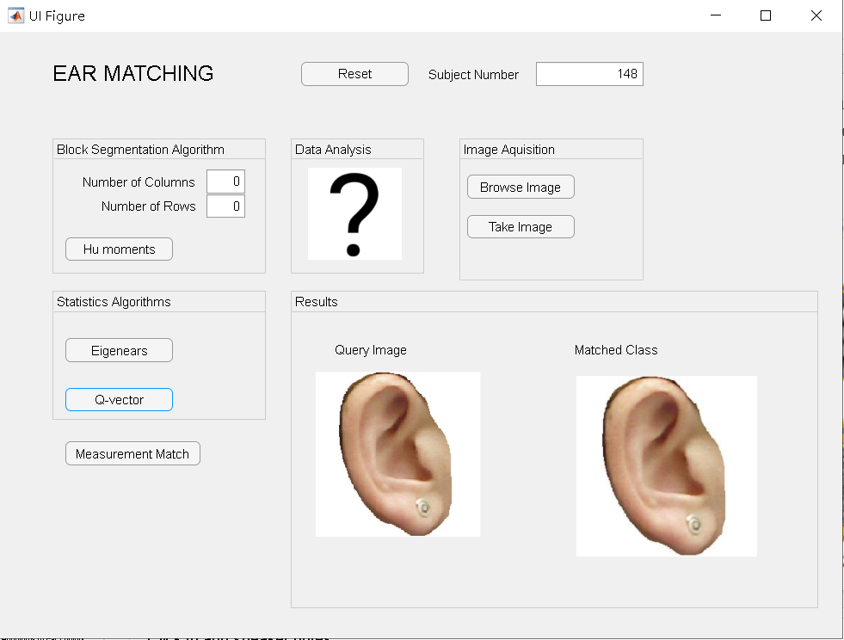
First: Open the App and browse the image into the app
Second: Choosing a function by click the button to start the Ear matching
Third: The matched image will be displayed along with the subject number of the image. To start another function, push the reset button and repeat the steps.

Slide 6
Files:
app1.mlapp: final app
CPIC_data.mat: database
Hu_moments.m: Hu moment matching function
eigenears.mlx: eigen ears matching function
HOGIX.mlx: Q-vector analysis matching function
Measurement_match.mlx: measurement matching function
Loading.mlx: loading bar
Facedection.m
Central_moment.m
centerofMass.m
Anthro.mat: finding subject number from index
cpic_right : images of ears (database)

